Slide 1
Lecture - 13
Chapter 6
COLOR IMAGE PROCESSING

Slide 2
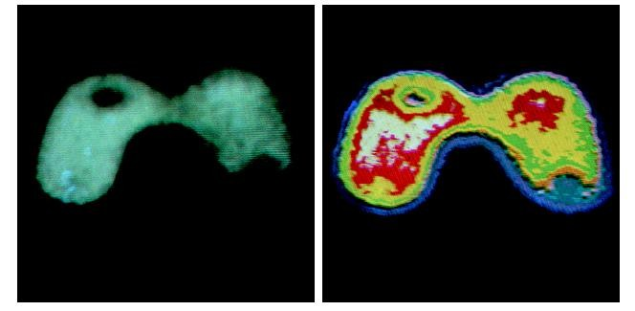
Color Fundamentals
Why use color in image processing?
Color is a powerful descriptor
Object identification and extraction
E.g. Face detection using skin colors
Humans can detect thousands of color shades and intensities
Human detect only two dozen shades of grays

Slide 3
Color Fundamentals
Two category of color image processing
Full color processing
Images are developed from full-color sensor or equipments
Pseudo-color processing
In the past decades, color sensors and processing hardware were not available
Colors were assigned to a range of monochrome intensities

Slide 4
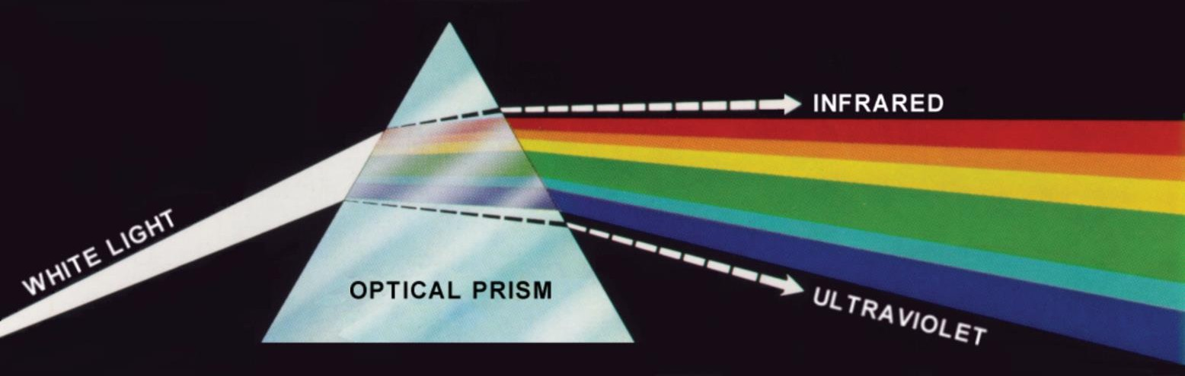
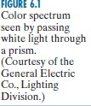
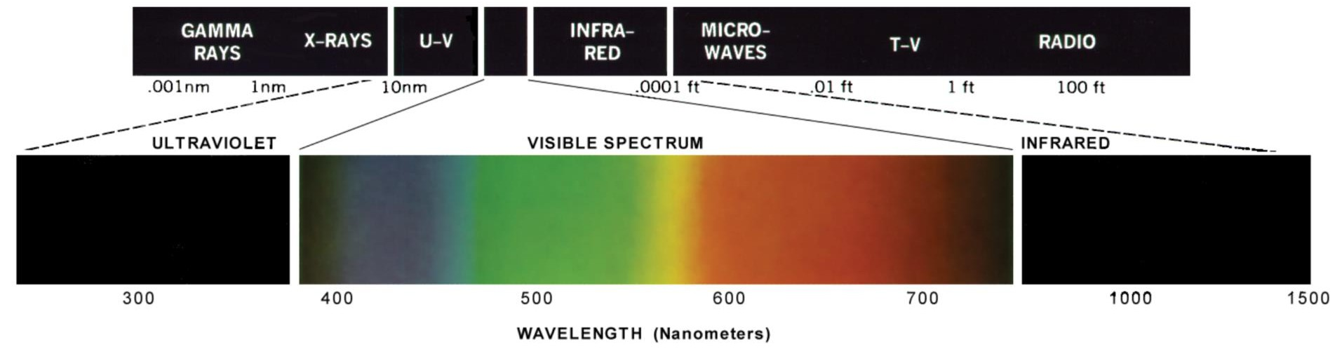

Color Fundamentals

Slide 5
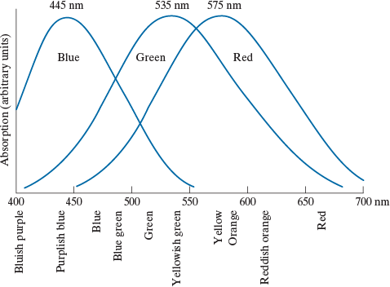

Color Fundamentals
6~7M Cones are the sensors in the eye
3 principal sensing categories in eyes: Red light 65%, green light 33%, and blue light 2%
CPE415 Digital Image Processing | Dr. Ikramullah Khosa

Slide 6

Color Fundamentals
The color that human perceive in an object = the light reflected from the object
scene
Illumination source
reflection
eye
CPE415 Digital Image Processing | Dr. Ikramullah Khosa
6

Slide 7
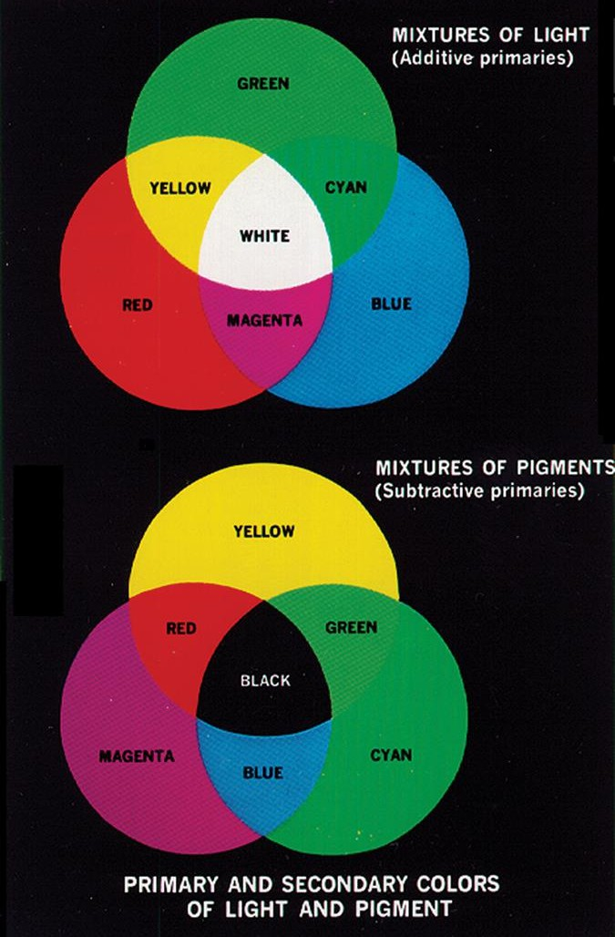

Primary colors of light vs. primary colors of pigments
Primary color of pigments
Color that subtracts or absorbs a primary color of light and reflects or transmits the other two
Color of light:
R
G
B
Color of pigments: | absorb R | absorb G | absorb B
 | Cyan | Magenta | Yellow
CPE415 Digital Image Processing | Dr. Ikramullah Khosa

Slide 8
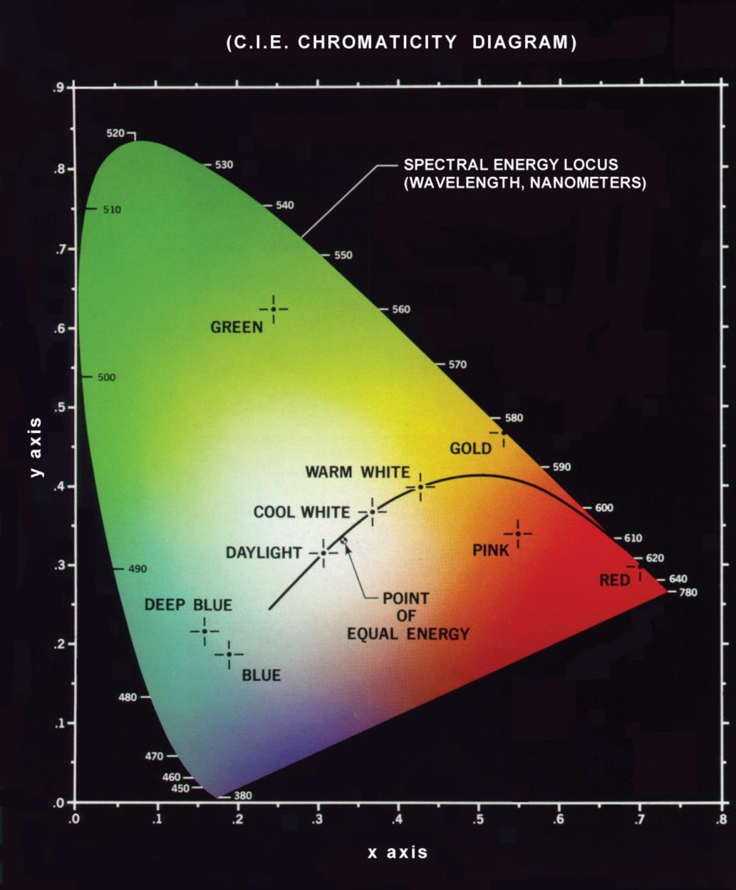

Chromaticity Diagram
Chromaticity refers to the quality of a color independent of its brightness. It describes what color looks like in terms of:
Hue (red, green, blue, etc.)
Saturation (how pure or intense the color is) but not how light or dark it is.
Normalized tristimulus values
x =
X
X + Y + Z Y
y =
X + Y + Z
Z
z =
X + Y + Z
x+y+z=1
x, y (chromaticity coordinate) is enough to describe all colors
z = 1 – (x+y)
CPE415 Digital Image Processing | Dr. Ikramullah Khosa
Notes:
Chromaticity refers to the quality of a color independent of its brightness. It describes what color looks like in terms of:
Hue (red, green, blue, etc.)
Saturation (how pure or intense the color is)
…but not how light or dark it is.

Slide 9
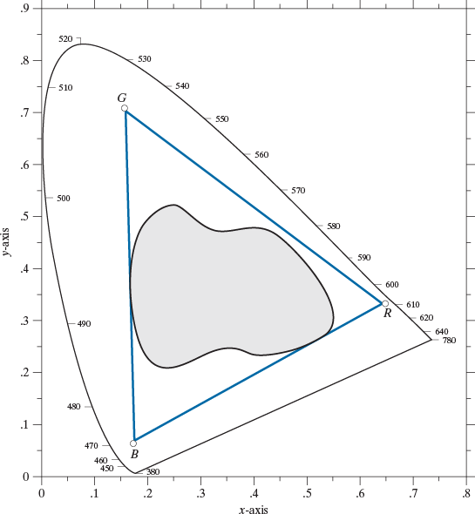

Chromaticity Diagram
RGB gamut of monitors
Color gamut of
printers
CPE415 Digital Image Processing | Dr. Ikramullah Khosa

Slide 10
Color Model
Color model, color space, color system
Specify colors in a standard way
A coordinate system that each color is represented by a single point
RGB model
CYM model
CYMK model
Suitable for display/hardware
HSI model
- Software processing (match the human description)
CPE415 Digital Image Processing | Dr. Ikramullah Khosa

Slide 11
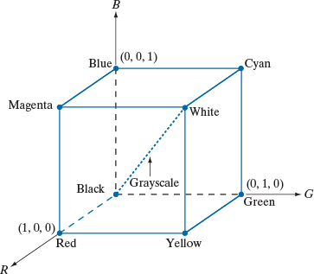



The RGB Color Model
Pixel depth: the number of bits used to represent each pixel in RGB space
Full-color image: 24-bit RGB color image
(R, G, B) = (8 bits, 8 bits, 8 bits)
CPE415 Digital Image Proces
sing | Dr. Ikramullah Khosa

Slide 12
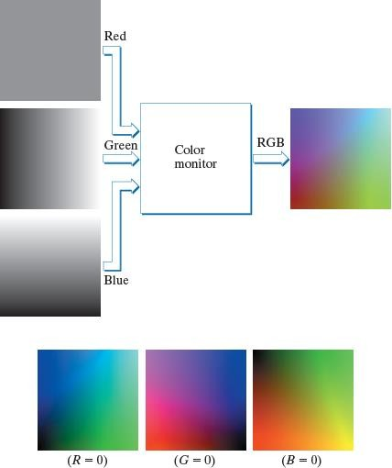

The RGB Color Model

Slide 13
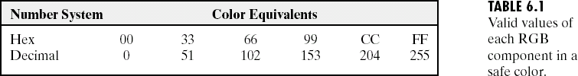
Safe RGB Colors
Subset of colors is enough for some application
Safe RGB colors (safe Web colors, safe browser colors)
(6)³ = 216

Slide 14
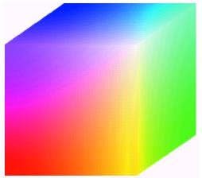
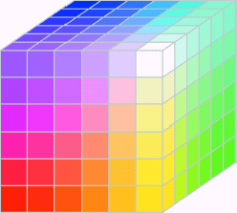
Safe RGB Colors
Full color cube
Safe color cube

Slide 15
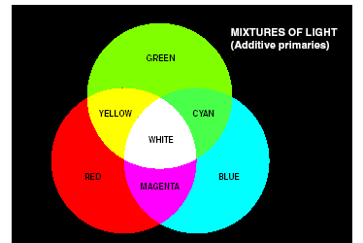
CMY (+Black = CMYK) Color Model
CMY: secondary colors of light, or primary colors of pigments
Used to generate hardcopy output
⎡ C ⎤ ⎡1⎤ ⎡R⎤
⎢_{M} ⎥ ₌ ⎢₁⎥ ₋ ⎢_{G}⎥
⎢ ⎥ ⎢ ⎥ ⎢ ⎥
⎢⎣1⎥⎦
⎢⎣ Y ⎥⎦
⎢⎣B⎥⎦

Slide 16
HSI Color Model
Will you describe a color using its R, G, B components?
Human describe a color by its hue, saturation, and brightness
Hue : color attribute
Saturation: purity of color (white->0, primary color->1)
Brightness: achromatic notion of intensity

Slide 17
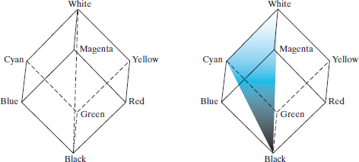

HSI Color Model
Colors on this triangle Have the same hue (Iso-hue triangle)
Intensity line
saturation

Slide 18
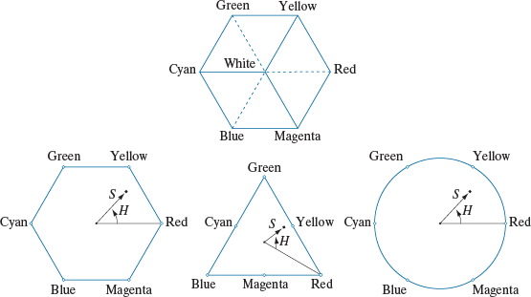
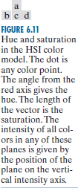
HSI Color Model

Slide 19
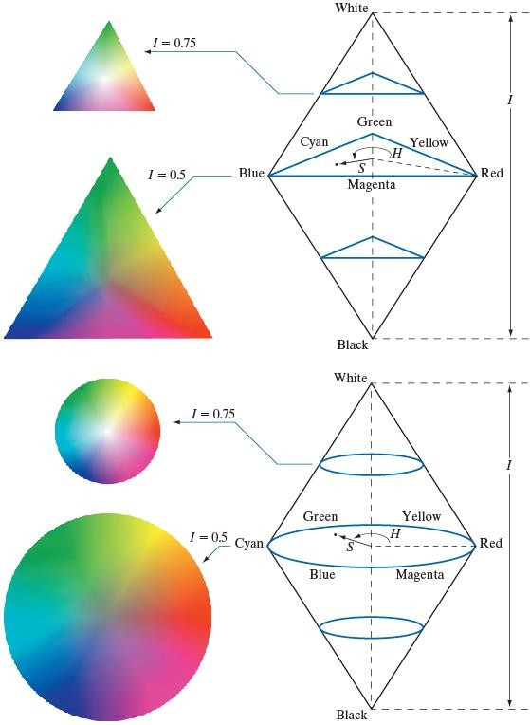

HSI Color Model

Slide 20
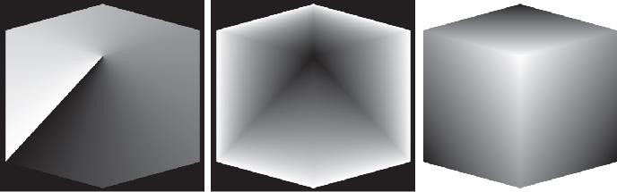
HSI Color Model

Slide 21


HSI Color Model

Slide 22

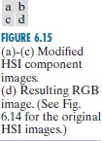
HSI Color Model

Slide 23
Pseudo-color Image Processing
Assign colors to gray values based on a specified criterion
For human visualization and interpretation of gray- scale events
Intensity slicing
Gray level to color transformations

Slide 24
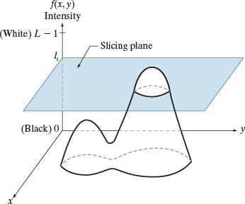

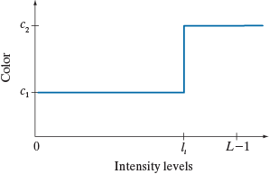

Intensity Slicing

Slide 25
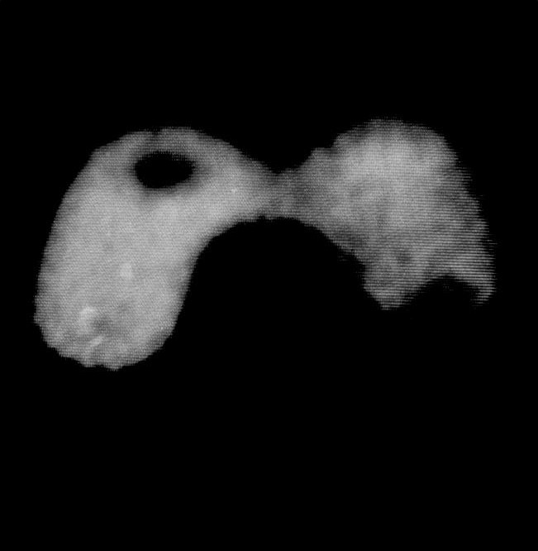
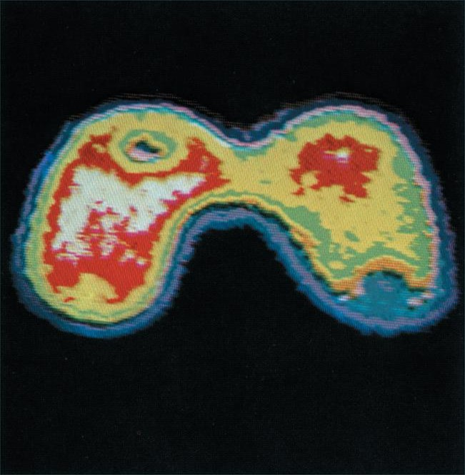
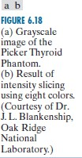
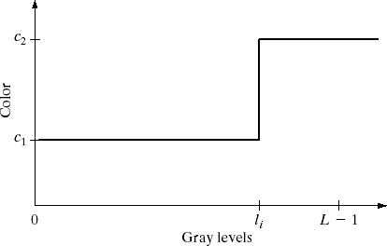
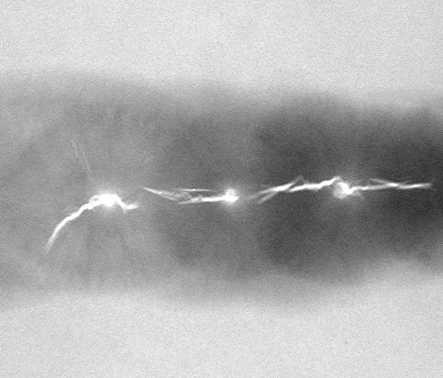


Intensity Slicing Application

Slide 26
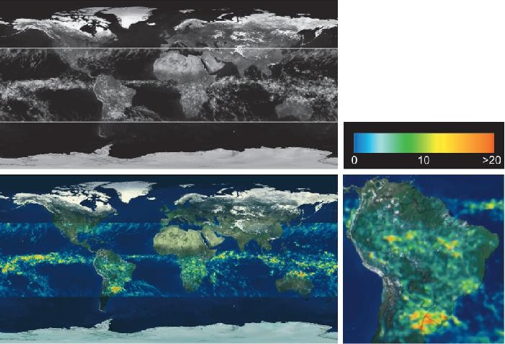

Intensity Slicing Application

